Slide 1

Bias and Variance
Presented by:
Elizer Ponio Jr.
Department of Computer Science
College of Computing and Information Technologies

Slide 2
Outline
True relationship curve
Simple models
Complex models
Bias
Variance
Overfitting
Finding the sweet spot

Slide 3
Sample Dataset
Price of Fuel | Jeepney Fare
0.2 | 0.4
0.8 | 3
2 | 2.5
2.5 | 4.5
3.5 | 3.7
4.9 | 4.1
0.3 | 2
1.5 | 1
1.8 | 4
3 | 3.5
3.8 | 4.8
4.1 | 3.8
4.7 | 4.5

Slide 4
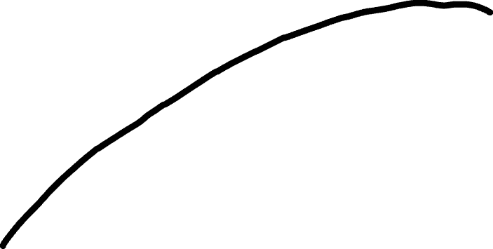
Jeepney Fare
True Relationship Curve
This curve represents the relationship between Price of Fuel and Jeepney Fare
Price of Fuel

Slide 5
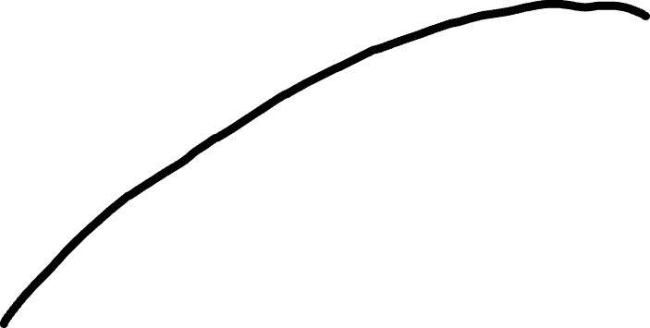
Jeepney Fare
Price of Fuel

Slide 6
Jeepney Fare
Price of Fuel

Slide 7
Jeepney Fare
Price of Fuel

Slide 8
Jeepney Fare
A simple model using an algorithm like Linear Regression fits a straight line to the training set
Price of Fuel

Slide 9
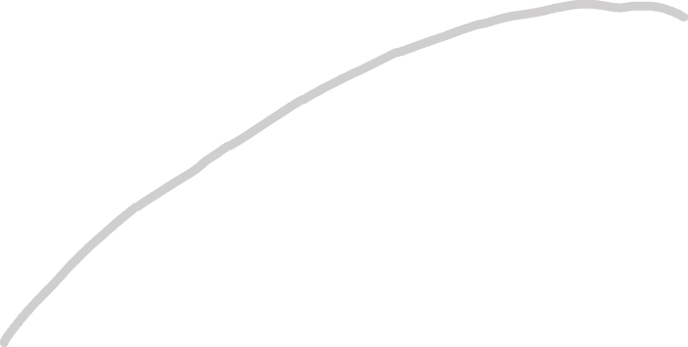
Jeepney Fare
The Straight Line does not have the flexibility to accurately replicate the arc in the “true” relationship
Price of Fuel

Slide 10
Jeepney Fare
The Straight Line will never capture the true relationship between Price of Fuel and Jeepney fare no matter how well we fit it to the training set
Price of Fuel

Slide 11
Jeepney Fare
The inability for a machine learning method to capture the true relationship is called bias
Price of Fuel

Slide 12
Jeepney Fare
Because the Straight Line cannot be curved
like the True relationship curve, it has a
relatively large amount of bias
Price of Fuel

Slide 13
Jeepney Fare
A complex model using a different machine learning algorithm
might fit a Squiggly line to the training set
Price of Fuel

Slide 14

Jeepney Fare
This Squiggly line is flexible and hugs the training set along the arc of the true relationship curve
Price of Fuel

Slide 15
Jeepney Fare
Because the Squiggly line can handle the arc in the true relationship between Price of Fuel and Jeepney Fare, it has very small bias
Price of Fuel

Slide 16
Jeepney Fare
Jeepney Fare
Price of Fuel
Price of Fuel
We can compare how well the Straight Line and the Squiggly line fit the training set by calculating their sums of squares.

Slide 17
Jeepney Fare
Jeepney Fare
Price of Fuel
Price of Fuel
In other words, we measure the distance between the data points and the fitted lines, square them up and add them together.

Slide 18
Jeepney Fare
Jeepney Fare
Price of Fuel
Price of Fuel
Notice how the Squiggly Line fits the data so well that the distances between the line and the data are all zero

Slide 19
Jeepney Fare
Jeepney Fare
Price of Fuel
Price of Fuel
In the contest to see whether the Straight Line fits the training set better than the Squiggly Line, the Squiggly line wins.

Slide 20
Jeepney Fare
Jeepney Fare
Price of Fuel
Price of Fuel
But remember, so far we have only calculated the Sums of Squares for the training set.

Slide 21
Jeepney Fare
Jeepney Fare
Price of Fuel
Price of Fuel
We also have the testing set

Slide 22
Jeepney Fare
Jeepney Fare
Price of Fuel
Price of Fuel
In a contest to see whether the Straight line fits the testing set better than the Squiggly line,
The Straight line wins!

Slide 23
Jeepney Fare
Jeepney Fare
Price of Fuel
Price of Fuel
Even though the Squiggly Line did a great job fitting the training set, it did a terrible job fitting the test set.

Slide 24
Jeepney Fare
Jeepney Fare
Price of Fuel
Price of Fuel
In machine learning lingo, the difference in fit between the training and test data sets is called variance

Slide 25
Jeepney Fare
The Squiggly line has low bias, since it is flexible and can adapt to the curve in the relationship between Price of Fuel and Jeepney Fare.
Price of Fuel

Slide 26
Jeepney Fare
But the Squiggly line has high variance, because the sums of squares for training and test set is vastly different
Price of Fuel

Slide 27
Jeepney Fare
Jeepney Fare
Price of Fuel
Price of Fuel
In other words, when you have high variance, it is hard to predict how well the Squiggly line will perform with future datasets. It might do well sometimes, and other times it might do terribly

Slide 28
Jeepney Fare
In contrast, the Straight line has relatively high bias, since it cannot capture the the curve in the true relationship between Price and Fare
Price of Fuel

Slide 29
Jeepney Fare
But the Straight line has relatively low variance, because the sum of squares are very similar between the training set and test set
Price of Fuel

Slide 30
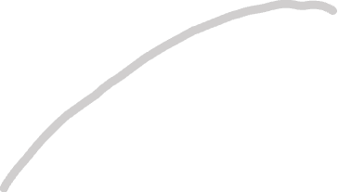
Jeepney Fare
Jeepney Fare
Price of Fuel
Price of Fuel
The Straight line might only give good predictions and not great predictions. But they will be consistently good predictions!

Slide 31

Jeepney Fare
Jeepney Fare
Price of Fuel
Price of Fuel
Because the Squiggly line fits the training data set really well but not the testing set, we say the the Squiggly line is overfit.

Slide 32

Jeepney Fare
In machine learning, the ideal algorithm has low bias and can accurately model the true relationship.
Price of Fuel

Slide 33

Jeepney Fare
Jeepney Fare
Price of Fuel
Price of Fuel
And it has low variance, by producing consistent predictions across different data sets

Slide 34
Jeepney Fare
Jeepney Fare
Price of Fuel
Price of Fuel
This is done by finding the sweetspot between and simple model
And a complex model

Slide 35
References
https://www.youtube.com/watch?v=EuBBz3bI-aA&list=PLblh5JKOoLUICTaGLRoHQDuF_7q2GfuJF&index=6&t=186s
https://www.simplilearn.com/tutorials/machine-learning-tutorial/bias-and-variance

